Slide 1
Computer Networks _22CS008
Multicast MAC Address, Broadcast MAC Address, Unicast MAC Address, ARP and RARP
Lecture (12-14)
Dr. Yogesh
Department of Computer Science and Engineering,
Chitkara University, Punjab

Slide 2
INDEX
Multicast MAC Address
Broadcast MAC Address
Unicast MAC Address
ARP and RARP

Slide 3
Multicast MAC Address
An Ethernet multicast frame is received and processed by a group of devices on the Ethernet LAN that belong to the same multicast group.
The features of an Ethernet multicast are as follows:
There is a destination MAC address of 01-00-5E when the encapsulated data is an IPv4 multicast packet and a destination MAC address of 33-33 when the encapsulated data is an IPv6 multicast packet.
There are other reserved multicast destination MAC addresses for when the encapsulated data is not IP, such as Spanning Tree Protocol (STP) and Link Layer Discovery Protocol (LLDP).
It is flooded out all Ethernet switch ports except the incoming port, unless the switch is configured for multicast snooping.
It is not forwarded by a router, unless the router is configured to route multicast packets.

Slide 4
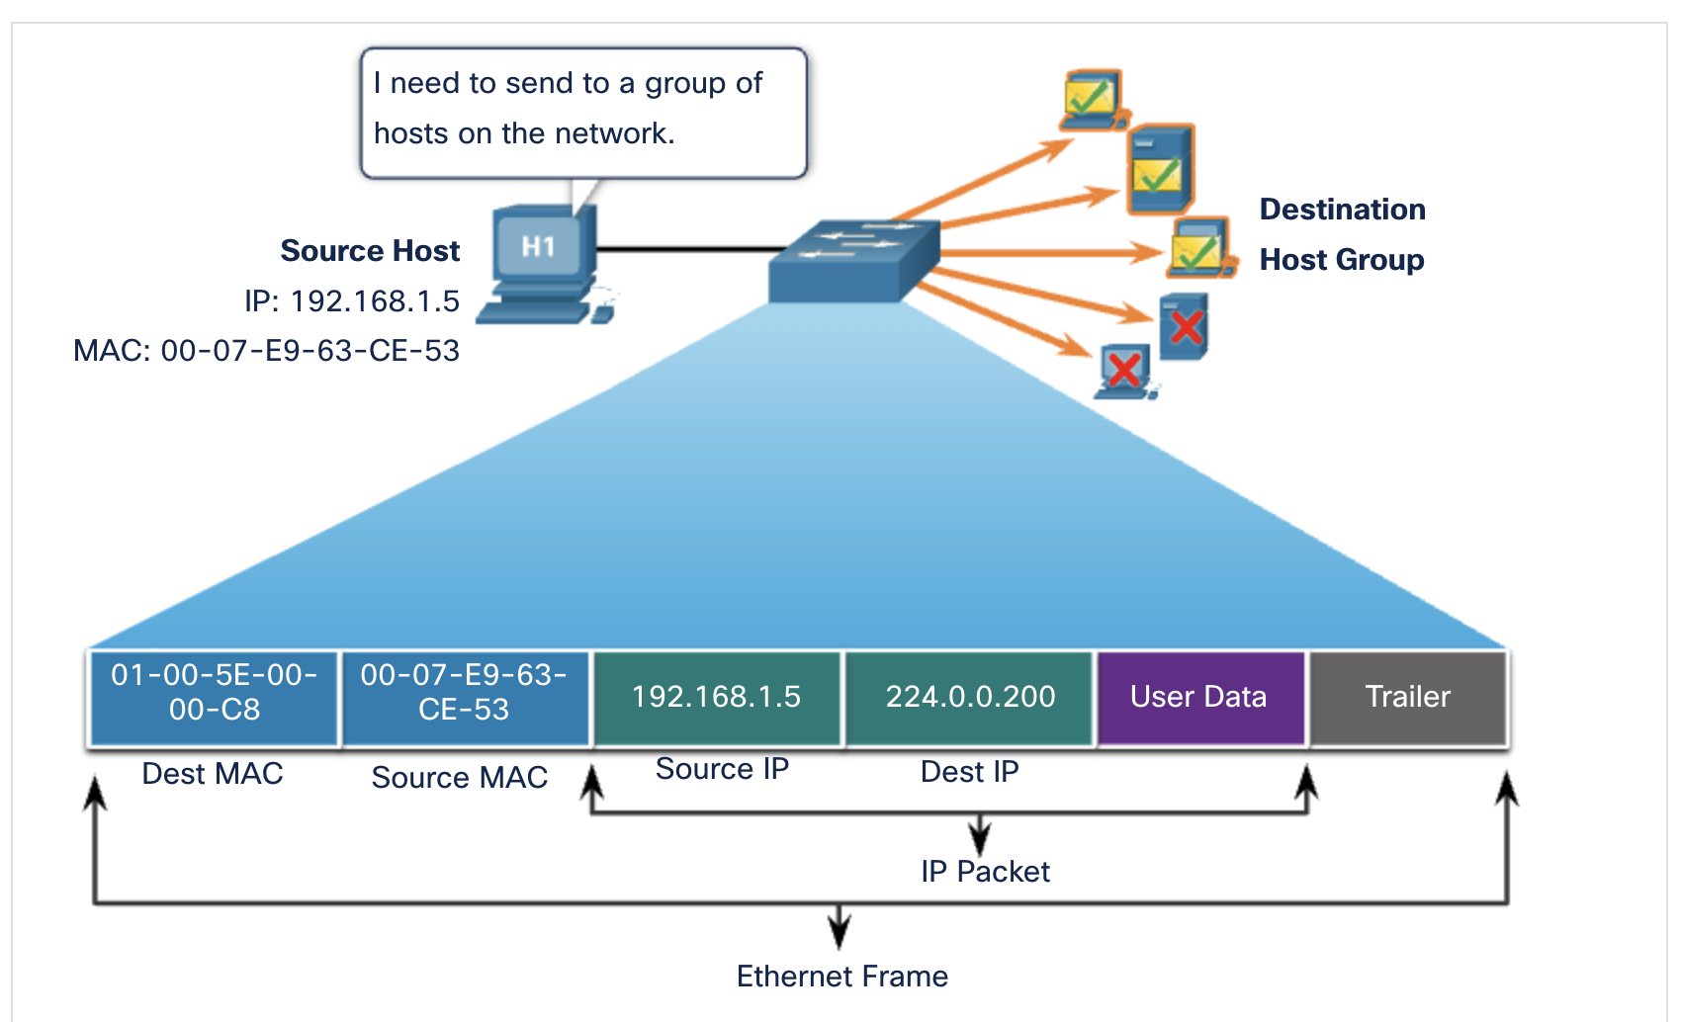
Multicast MAC Address
Fig. Multicast MAC Address
In the Fig. the destination MAC address and destination IP address are both multicasts.
Routing protocols and other network protocols use multicast addressing.
Applications such as video and imaging software may also use multicast addressing, although multicast applications are not as common.

Slide 5
Multicast MAC Address
If the encapsulated data is an IP multicast packet, the devices that belong to a multicast group are assigned a multicast group IP address.
The range of IPv4 multicast addresses is 224.0.0.0 to 239.255.255.255.
The range of IPv6 multicast addresses begins with ff00::/8. Because multicast addresses represent a group of addresses (sometimes called a host group), they can only be used as the destination of a packet.
The source will always be a unicast address.
As with the unicast and broadcast addresses, the multicast IP address requires a corresponding multicast MAC address to deliver frames on a local network.
The multicast MAC address is associated with, and uses addressing information from, the IPv4 or IPv6 multicast address.

Slide 6
Broadcast MAC Address
An Ethernet broadcast frame is received and processed by every device on the Ethernet LAN.
The features of an Ethernet broadcast are as follows:
It has a destination MAC address of FF-FF-FF-FF-FF-FF in hexadecimal (48 ones in binary).
It is flooded out all Ethernet switch ports except the incoming port.
It is not forwarded by a router.
If the encapsulated data is an IPv4 broadcast packet, this means the packet contains a destination IPv4 address that has all ones (1s) in the host portion. This numbering in the address means that all hosts on that local network (broadcast domain) will receive and process the packet.

Slide 7
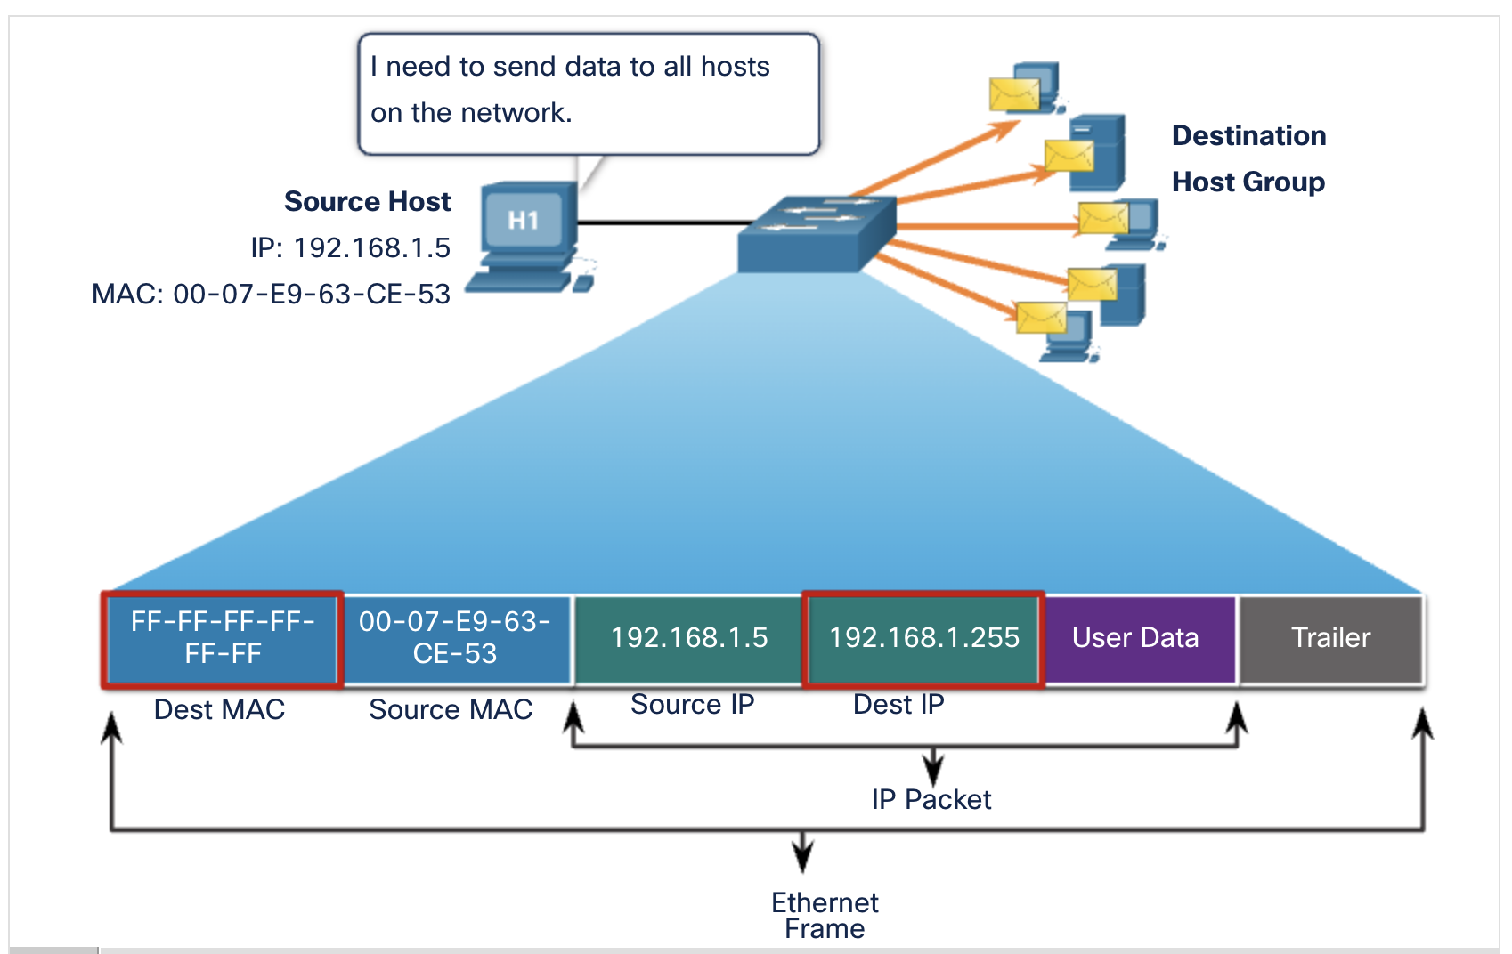
Broadcast MAC Address
Fig. Broadcast MAC Address
In this Fig. the destination MAC address and destination IP address are both broadcasts.

Slide 8
Broadcast MAC Address
The source host sends an IPv4 broadcast packet to all devices on its network.
The IPv4 destination address is a broadcast address, 192.168.1.255.
When the IPv4 broadcast packet is encapsulated in the Ethernet frame, the destination MAC address is the broadcast MAC address of FF-FF-FF-FF-FF-FF in hexadecimal (48 ones in binary).
DHCP for IPv4 is an example of a protocol that uses Ethernet and IPv4 broadcast addresses.
However, not all Ethernet broadcasts carry an IPv4 broadcast packet.
For example, ARP Requests do not use IPv4, but the ARP message is sent as an Ethernet broadcast.

Slide 9
Unicast MAC Address
In Ethernet, different MAC addresses are used for Layer 2 unicast, broadcast, and multicast communications.
A unicast MAC address is the unique address that is used when a frame is sent from a single transmitting device to a single destination device.
The process that a source host uses to determine the destination MAC address associated with an IPv4 address is known as Address Resolution Protocol (ARP). The process that a source host uses to determine the destination MAC address associated with an IPv6 address is known as Neighbor Discovery (ND).
Note: The source MAC address must always be a unicast.

Slide 10
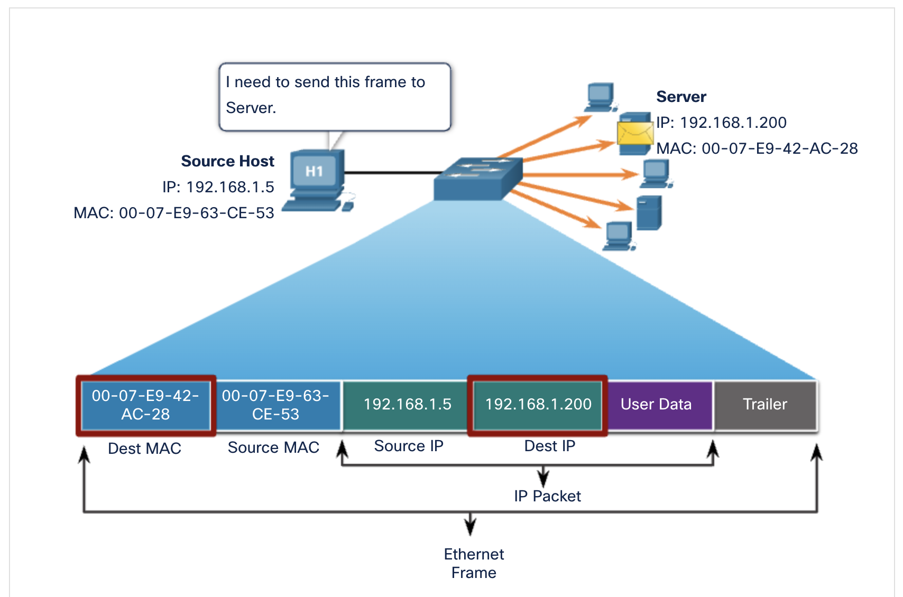
Unicast MAC Address
Fig. Unicast MAC Address
In this figure, the destination MAC address and the destination IP address are both unicast.
A host with IPv4 address 192.168.1.5 (source) requests a web page from the server at IPv4 unicast address 192.168.1.200. For a unicast packet to be sent and received, a destination IP address must be in the IP packet header. A corresponding destination MAC address must also be present in the Ethernet frame header. The IP address and MAC address combine to deliver data to one specific destination host.

Slide 11
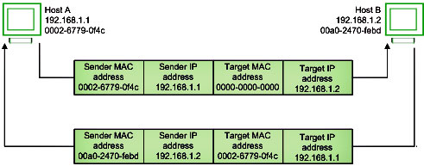
ARP and RARP
Address Resolution Protocol (ARP)
Address Resolution Protocol is a communication protocol used for discovering physical address associated with given network address. Typically, ARP is a network layer to data link layer mapping process, which is used to discover MAC address for given Internet Protocol Address. In order to send the data to destination, having IP address is necessary but not sufficient; we also need the physical address of the destination machine. ARP is used to get the physical address (MAC address) of destination machine.
Fig. Address Resolution Protocol (ARP)

Slide 12
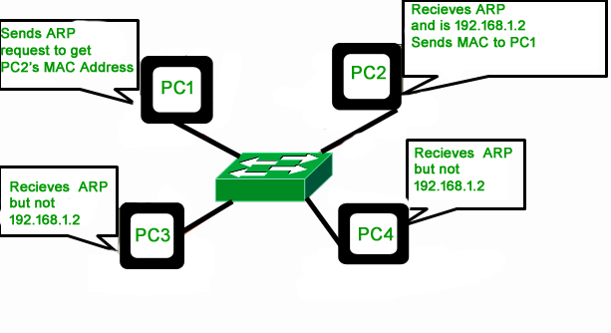
Address Resolution Protocol (ARP)
Before sending the IP packet, the MAC address of destination must be known.
If not so, then sender broadcasts the ARP-discovery packet requesting the MAC address of intended destination.
Fig. Address Resolution Protocol (ARP)

Slide 13
Address Resolution Protocol (ARP)
Since ARP-discovery is broadcast, every host inside that network will get this message but the packet will be discarded by everyone except that intended receiver host whose IP is associated.
Now, this receiver will send a unicast packet with its MAC address (ARP-reply) to the sender of ARP-discovery packet.
After the original sender receives the ARP-reply, it updates ARP-cache and start sending unicast message to the destination.

Slide 14
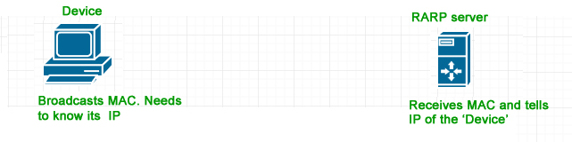
Reverse Address Resolution Protocol (RARP)
Reverse ARP is a networking protocol used by a client machine in a local area network to request its Internet Protocol address (IPv4) from the gateway-router’s ARP table.
The network administrator creates a table in gateway-router, which is used to map the MAC address to corresponding IP address.
When a new machine is setup or any machine which don’t have memory to store IP address, needs an IP address for its own use.
So the machine sends a RARP broadcast packet which contains its own MAC address in both sender and receiver hardware address field.
Fig. RARP

Slide 15
Reverse Address Resolution Protocol (RARP)
A special host configured inside the local area network, called as RARP-server is responsible to reply for these kind of broadcast packets. Now the RARP server attempt to find out the entry in IP to MAC address mapping table.
If any entry matches in table, RARP server send the response packet to the requesting device along with IP address.
LAN technologies like Ethernet, Ethernet II, Token Ring and Fiber Distributed Data Interface (FDDI) support the Address Resolution Protocol.
RARP is not being used in today’s networks. Because we have much great featured protocols like BOOTP (Bootstrap Protocol) and DHCP( Dynamic Host Configuration Protocol).

Slide 16
Practice Questions
Q- The address resolution protocol (ARP) is used for
Finding the IP address from the DNS
Finding the IP address of the default gateway
Finding the IP address that corresponds to a MAC address
Finding the MAC address that corresponds to an IP address
Q - There are the following statements that are given below, which of them are correct ARP?
The ARP protocol is used to get destination MAC address from the destination IP
address.
B. The ARP protocol is used to get the destination IP address from the destination MAC
address.
C. The ARP stands for Address Resolution Protocol.
D. The ARP protocol works on the same network as well as connected networks.
A and C
A and B
A, C and D
B, C, and D

Slide 17
Practice Questions
Q-The ARP protocol operates on which layer of the OSI model?
Physical Layer
Network Layer
Session Layer
Application
Q-In which year ARP was defined first time in Request for Comment?
1982
1985
1988
1990

